Slide 1
Practice quiz
Year 7 Physics

Slide 2
1. Which one of the following is NOT an example of a force?
a) The resistance of rough ground, when you drag something over it.
b) The thrust of your foot on a bicycle pedal.
c) The weight of a rock.
d) The height of a tree.

Slide 3
2. Which one of the following is a distance force?
a) Friction.
b) Magnetism.
c) Air pressure.
d) Elastic force

Slide 4
3. Which one of the following things can a force do?
a) Start motion
b) Stop motion
c) Change the direction of motion
d) Change the shape of an object
e) All of A, B, C and D

Slide 5
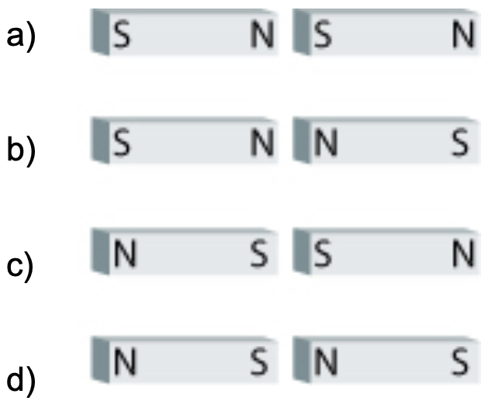
4. Which one of the following pairs of magnets will be attracted to each other?

Slide 6
5. Which two of the following statements are correct?
a) The Earth has its own magnetic field.
b) All objects that are made of iron are magnets.
c) The North Pole of the Earth is the north pole of a giant magnet.
d) Magnets can attract some materials without touching them.

Slide 7
6. Which of the following is an example of static electricity?
a) a light bulb glowing
b) hair getting attracted to a balloon
c) using a compass to find north
d) ‘blu-tac’ holding a poster on a wall

Slide 8
7. Which of the following electrostatic charges are attracted to each other:
- a) positive and positive
- b) negative and positive
- c) negative and negative
- d) none of the above

Slide 9
8. The units used to measure forces are:
a) Newton (N)
b) Centimetre (Cm)
c) Decibel (Db)
d) Kilogram (Kg)

Slide 10
9. Which of the following does NOT reduce Friction?
a) Lubricating the surfaces of objects
b) Reducing the amount of pressure on the objects
c) Reducing the amount of contact between objects
d) Increasing the roughness of the surface of objects.

Slide 11
10. What three particles are atoms made up of?
a) Proteins, Negatrons and Electrons
b) Positrons, Neutrons and Electrodes
c) Protons, Neutrons and Electrons
d) None of the above

Slide 12
11. Gravity is the force of:
a) Attraction
b) Addition
c) Subtraction
d) Repulsion

Slide 13
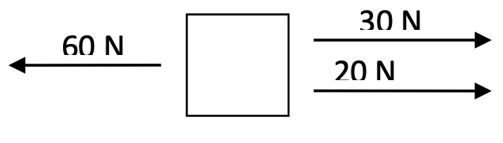
12. What is the overall (net) force on the box shown below?
a) 10Ntotheleft
b) 10 N to the right
c) 60Ntotheleft
d) 50 N to the right

Slide 14
13. When you slide a box across the floor what force must your push be stronger than?
a) Support force
b) Friction force
c) Gravity
d) Air resistance

Slide 15
14. The moon has a smaller mass than the Earth. If you were able to travel to the moon your weight would...
a) Increase
b) Decrease
c) Stay the same
d) Vary with day and night

Slide 16
15. This test paper is sitting at rest on your desk. Which of the following statements best describes this situation?
a) There are no forces acting on your paper.
b) Your paper pushes on the desk only.
c) The desk pushes on your paper only
d) The forces acting on the paper are balanced.

Slide 17
16. A change to an objects motion is caused by...
a) Balanced forces
b) Unbalanced forces
c) Acceleration
d) Velocity

Slide 18
17. When you walk across the ground and push on it with your feet...
a) There is no effect on the ground.
b) The ground pushes back less strongly than your feet.
c) The ground pushes back more strongly than your feet.
d) The ground pushes back on your feet with equal force.

